Slide 1
Evaluation of Biomechanics Associated with Muscle Spindle Afferent Firing
BE-GY 6783 Biomechanics for Biomedical Engineers
Presentation by Faisal Reza, Dipta Paul, Supreeth Krishna

Slide 2
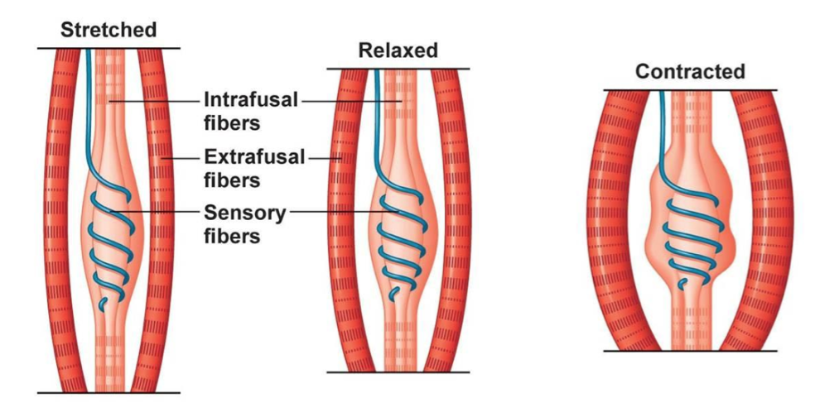
Overview
Background and function of muscle spindle firing
Biomechanics of muscle contraction
Methods for biocomputational modeling
Results
Conclusion and future directions
[1]

Slide 3
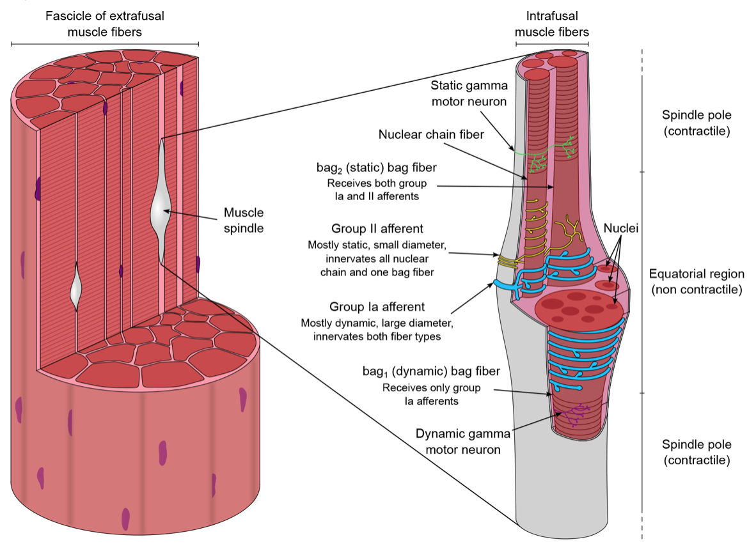
Muscle Spindle Morphology
[2]
Muscle spindle: two contractile polar regions and central non-contractile zone
Two fibre types: nuclear bag (dynamic and static) and nuclear chain
Group Ia and Group II afferents

Slide 4
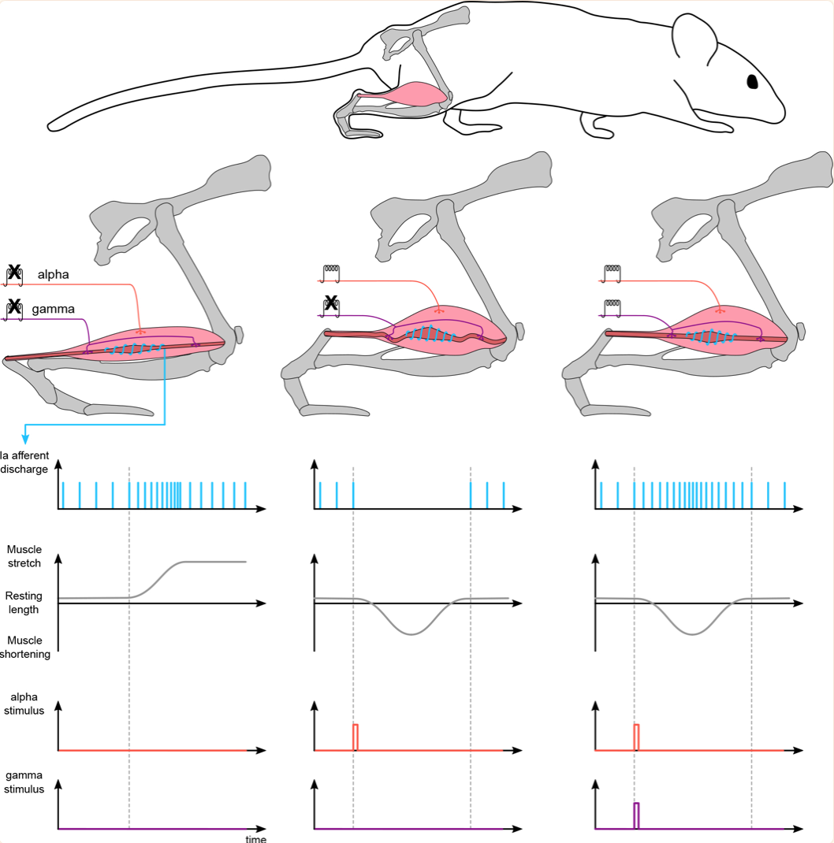
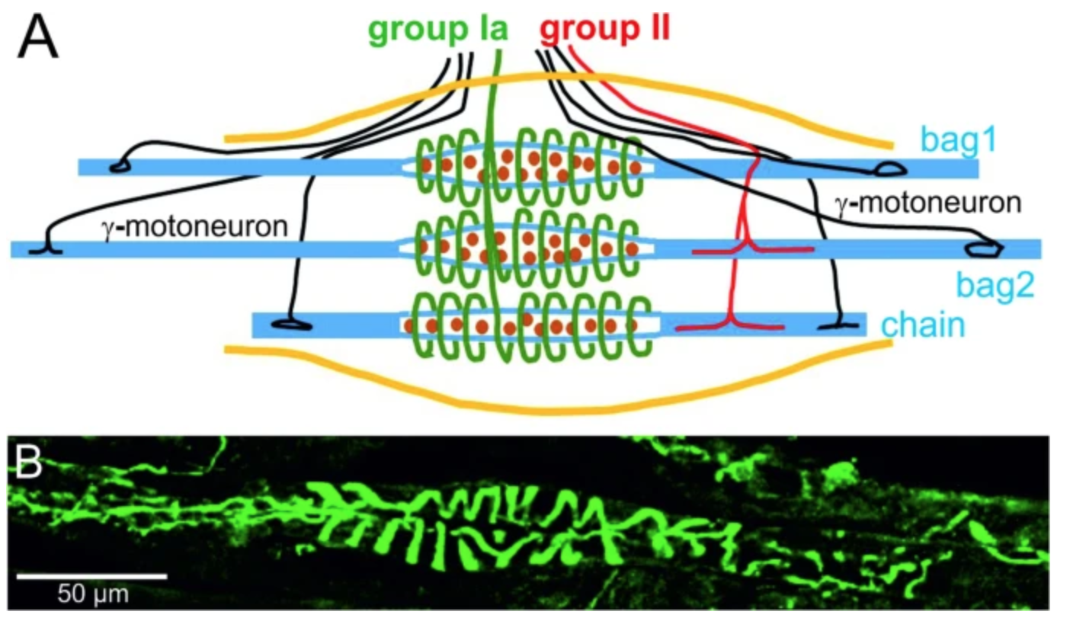
Muscle Spindle Function
[2]
[3]

Slide 5
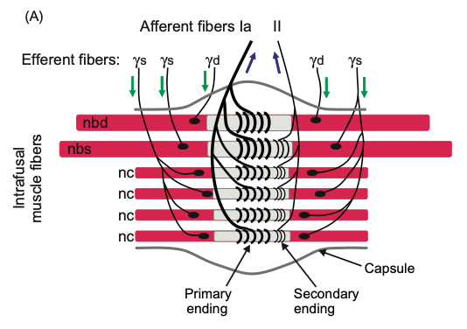
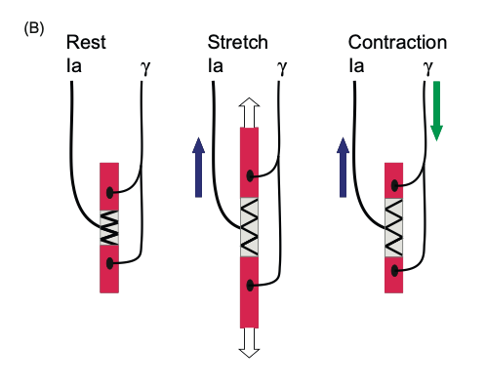
Muscle Spindle Physiology
[4]
[4]

Slide 6
Significance
Neuromechanical interactions that lead to muscle spindle firing patterns still poorly understood, necessary to develop framework for how muscle spindle generate complex sensory signals [2]
Critical in neurological disorders and during interactions with devices/interventions to improve motor impairment
Biophysical modeling approach to build muscle spindle model based on principles of intrafusal muscle contractile mechanics

Slide 7
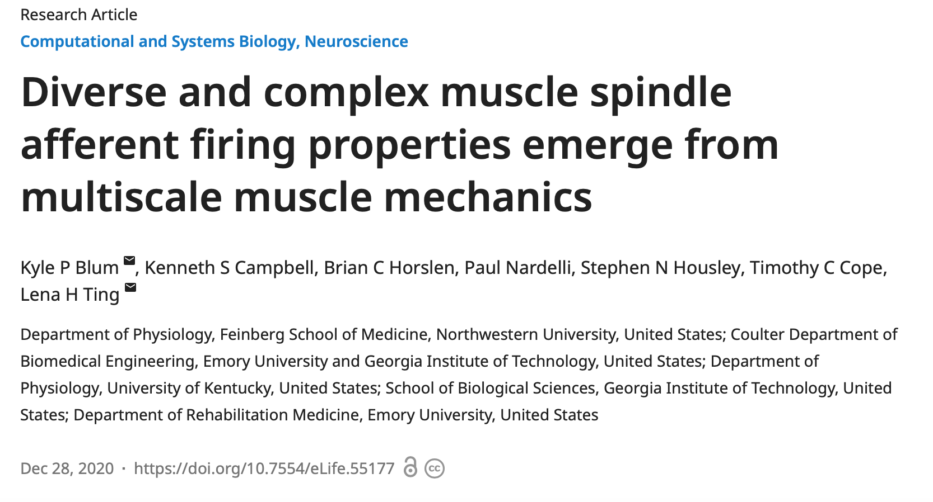
Current research

Slide 8
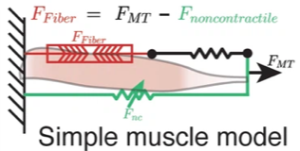
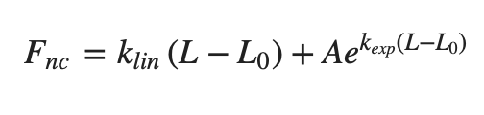
Muscle Spindle Modeling
[5]
Assume idealized musculotendon mechanical arrangement, noncontractile passive connective tissue arranged mechanically in parallel with muscle fibers
Assume noncontractile tissue acted as nonlinear spring of the form [5]:
k(lin), k(esp), A ≥ 0

Slide 9
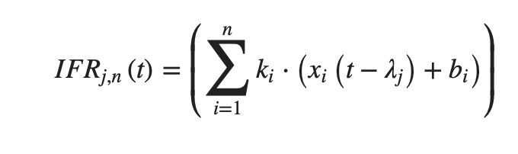
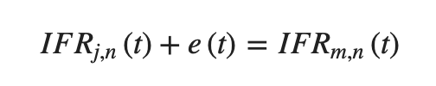
Instantaneous Firing Rate Modeling
[5]
Time delay determined accounting for apparent delay between muscle force response and onset of spiking response
IFR estimate of the jth model for the nth perturbation
Estimated by a sum of n force- or length-related variables, offset by a single value bi and scaled by a gain of k
[5]
Model estimates for IFR were related to the recorded IFR of the mth afferent by above equation
Error e(t) minimized by finding set of parameters for each model that minimizes measure related to e(t)^2

Slide 10
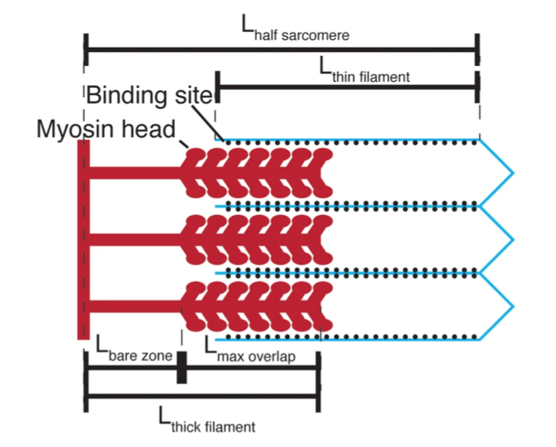
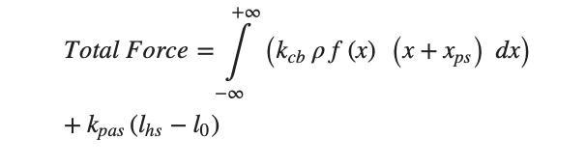
Intrafusal Muscle Modeling
[5]
[5]
Force in each half sarcomere calculated as sum of two components: active component generated by cycling activity of myosin heads and passive component generated by simulated linear spring
Model calculates force of half sarcomere at each time step, adds forces generated from each myosin head attached to actin binding site (active force) with elastic force of titin (passive force)
Focused on thick filament kinetics and greatly simplified thin filament instead of simulated coupled dynamics between myosin heads and actin binding sites

Slide 11
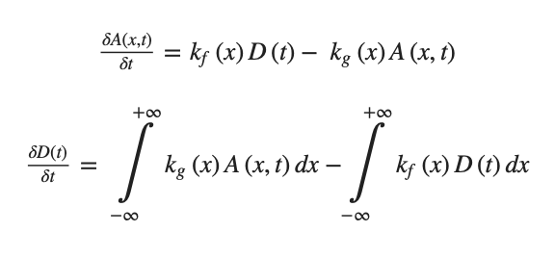
[5]
Myosin cycling dynamics were modeled using a two-state system in which each myosin head could either be attached as a cross-bridge with length x, or detached
Numbers of myosin heads in each of these states were governed by the system of partial differential equations

Slide 12
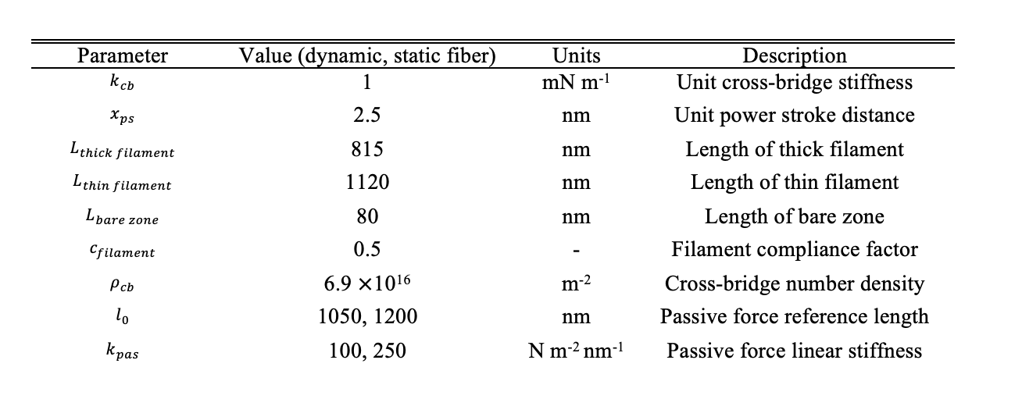
Computational Model Parameters
[5]
Constant parameters used in both dynamic and static intrafusal muscle fiber models
Parameters did not change in any simulation

Slide 13
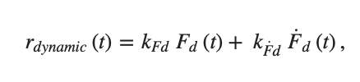
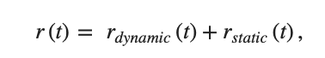
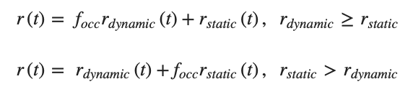
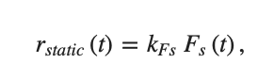
Muscle Spindle Response to Stretch
Model consists of two intrafusal muscle fiber models, a static fiber and a dynamic fiber based on observations that muscle spindle primary afferent responses to stretch consist of two components
[5]
Dynamic component where kFd and kF˙d are constants, and Fd(t) and F˙d(t) are respectively the force and yank of the cycling cross-bridges in the dynamic fiber
[5]
where the total firing rate of the afferent, r(t), is a sum of the dynamic and static fiber components
[5]
[5]
Static component where kFs is a constant and Fs(t) is the total force in the static fiber
To account for evidence of occlusive interaction between dynamic and static branches of the muscle spindle Ia afferent ending

Slide 14
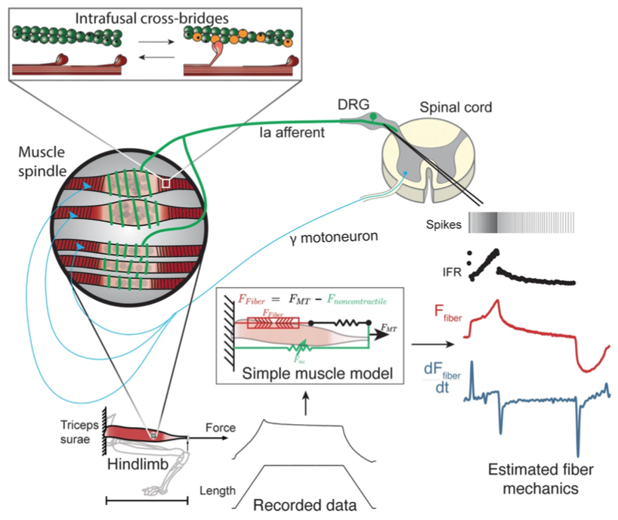
Methodology
[5]
Recorded muscle spindle afferent axonal potentials and computed instantaneous firing rates (IFRs) in anesthetized rats while stretching the triceps surae muscles
Muscle fiber forces were estimated by subtracting noncontractile forces from measured whole musculotendon force

Slide 15
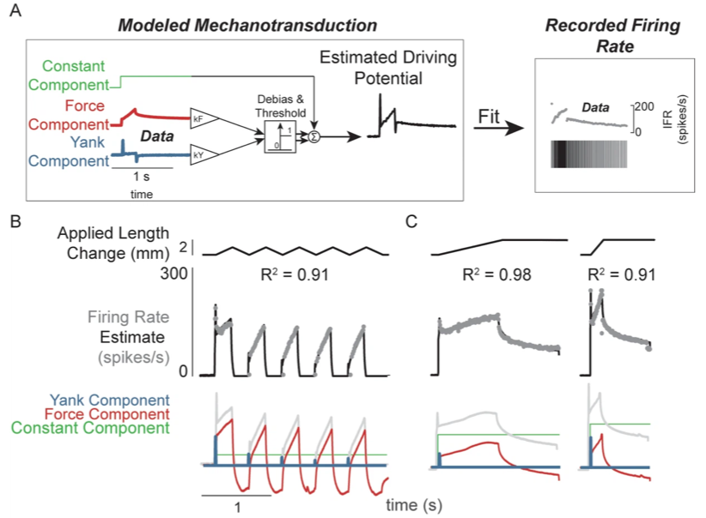
[5]

Slide 16
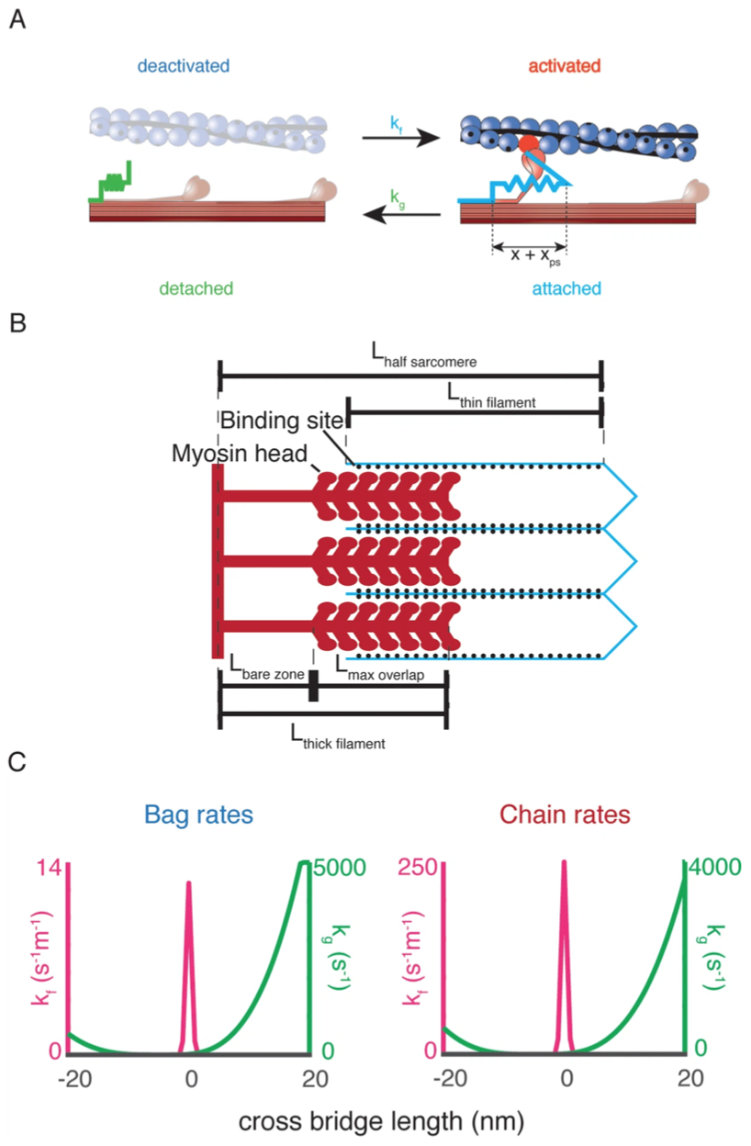
[5]

Slide 17
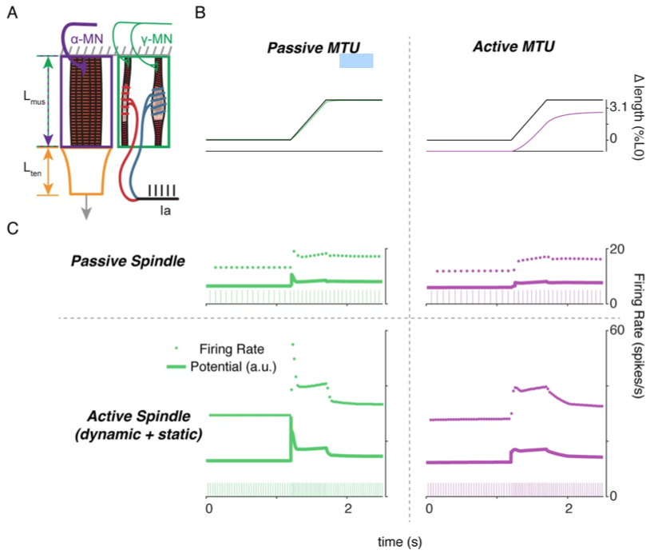
[5]

Slide 18
Discussion and shortcomings
[5]
Designed model with slow cycling myosin in the ‘dynamic’ fiber and fast cycling myosin in the ‘static’ fiber, modeled after nuclear bag and chain fibers
Dynamic and static fusimotor effects on Ia afferent stretch sensitivity were closely predicted
Variations in force and yank sensitivity account for both overall firing characteristics as well as ‘static-dynamic’ variability across Ia afferents
Mechanistic model used the simplest two-state cross-bridge model of actin-myosin interactions
Impossible to separate the elastic contributions from endomysial tissue from those in myofilaments [5]

Slide 19
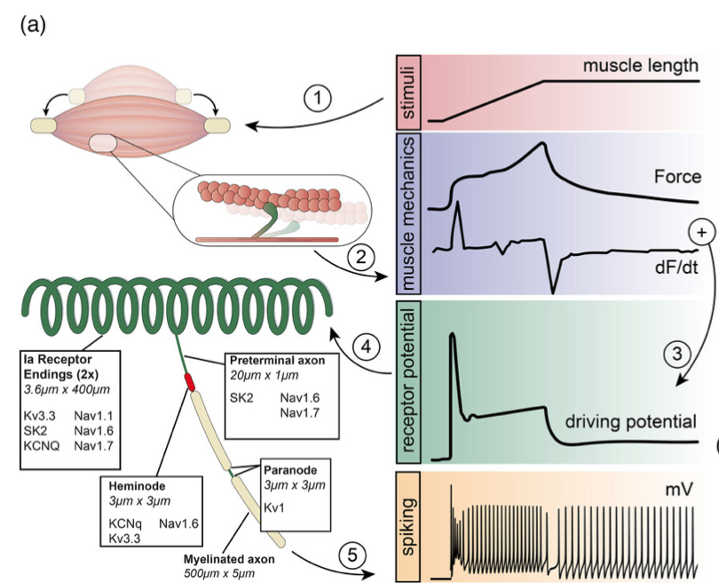
Future Direction
[6]
Missing in models are details about potential neuronal factors regulating spindle firing such as the asymmetrically distributed voltage gated ion channels (VGCs)
Asymmetric composition and spatial distribution of these VGCs could impact spindle afferent firing, as they do in neurons in the peripheral, central and autonomic nervous systems
Construct computational model built upon muscle cross-bridge model including distribution of VGCs [6]

Slide 20
References
[1] Myers, T. (2016). Spindles and GTO’s: Explaining the Gamma System - Technique News. Anatomy Trains. https://www.anatomytrains.com/blog/2014/02/17/spindles-gtos-explaining-gamma-system/
[2] Santuz, A., & Akay, T. (2023). Muscle spindles and their role in maintaining robust locomotion. The Journal of physiology, 601(2), 275-285.
[3] Kröger, S., & Watkins, B. (2021). Muscle spindle function in healthy and diseased muscle. Skeletal Muscle, 11(1), 3.
[4] Celichowski, J., & Krutki, P. (2019). Motor units and muscle receptors. In Muscle and Exercise Physiology (pp. 51-91). Academic Press.
[5]Blum, K. P., Campbell, K. S., Horslen, B. C., Nardelli, P., Housley, S. N., Cope, T. C., & Ting, L. H. (2020). Diverse and complex muscle spindle afferent firing properties emerge from multiscale muscle mechanics. Elife, 9, e55177.
[6] Housley, S. N., Powers, R. K., Nardelli, P., Lee, S., Blum, K., Bewick, G. S., ... & Cope, T. C. (2024). Biophysical model of muscle spindle encoding. Experimental Physiology, 109(1), 55-65.

Slide 21
Thank you!

